Slide 1


ToolShare: Release 1
Team Fourtran
Connor Hack, Tyler Paulsen, Zach Lauzon,
Ben Wilcox, Brendan John

Slide 2
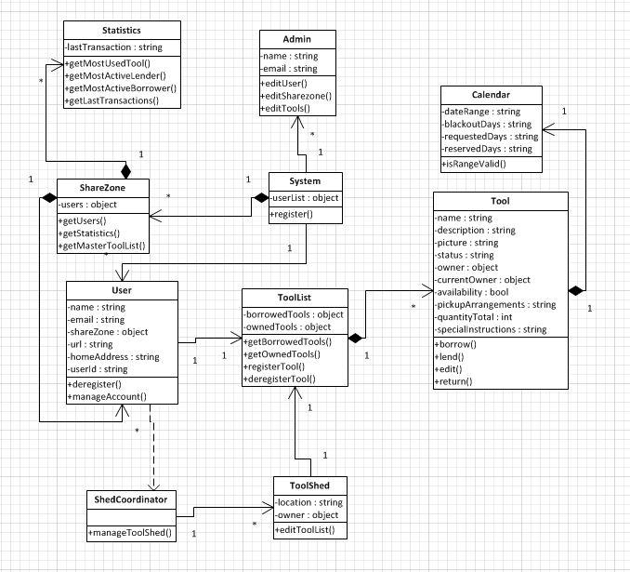
Planning

Slide 3

Coordination

Slide 4


Collaboration & Configuration

Slide 5
Concerns
Release 1
Registration
Account Management
Tool Listing
Tool Management
Release 2
Community Shed
Sharing
Borrowing
Community Statistics

Slide 6
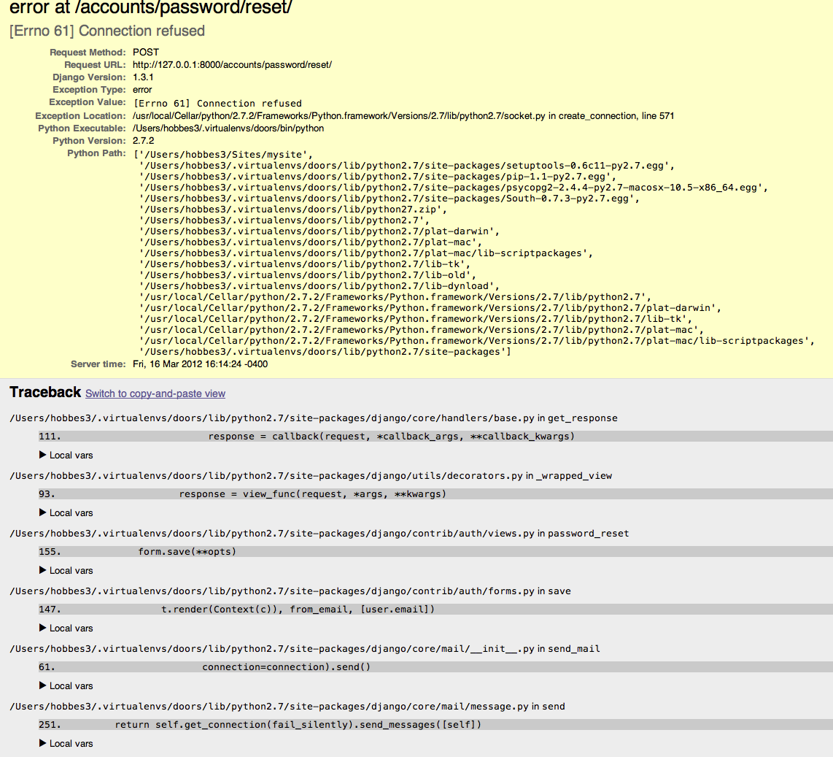
Coding Conflicts

Slide 7
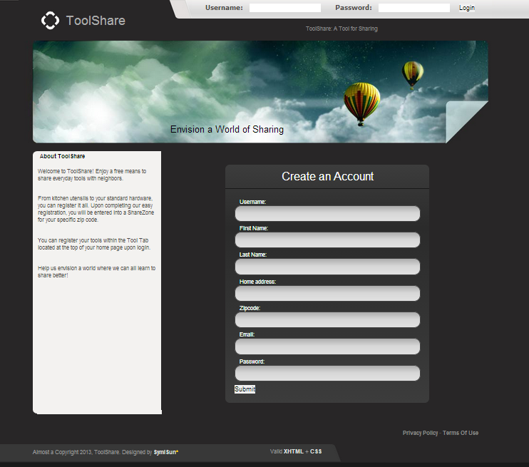
Home Page
Future Changes: None

Slide 8
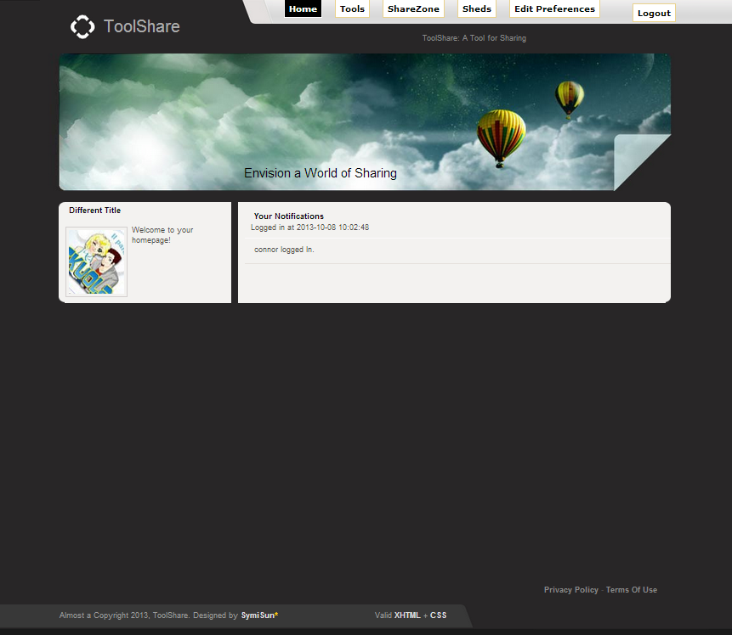
User Page
Future Changes: Notifications include: Borrow Requests, Acceptance/Denial, Tool/Preferences

Slide 9
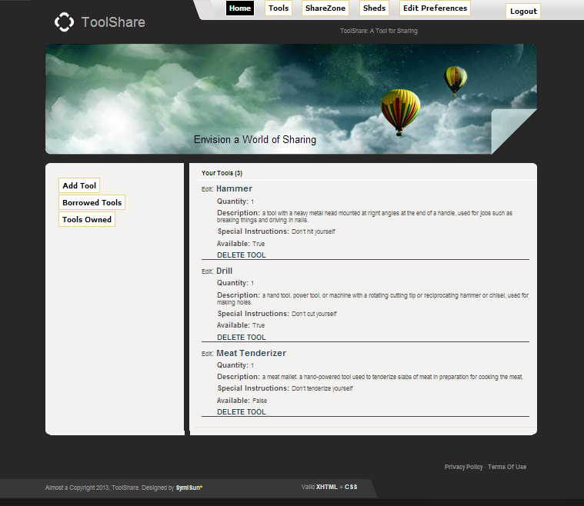
Tools
Future Changes: Redesign Layout, Ability to Filter Tools

Slide 10
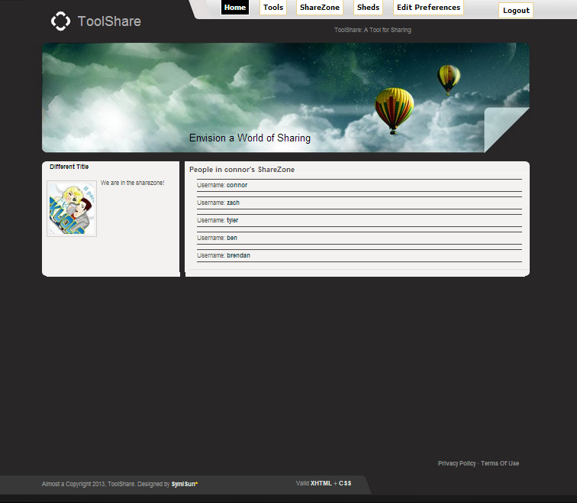
ShareZones
Future Changes: Ability to Filter through Users and Tools within ShareZones

Slide 11
Sheds/Edit Preferences

Slide 12
http://economicdevelopmentportal.com/wp-content/uploads/2010/07/Meeting-Clipart.jpg
http://svn.haxx.se/dev/archive-2008-07/att-0454/subversion-background.png
http://i1.ytimg.com/vi/JcJKoleL3Z8/maxresdefault.jpg
http://www.webapptesting.com/wp-content/uploads/2012/07/Test-Tools.jpg
References

